Slide 1


Saif Al-Dilaimi
Software Entwickler
saif.aldilaimi@icloud.com
Der Convolution Layer

Slide 2
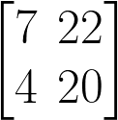
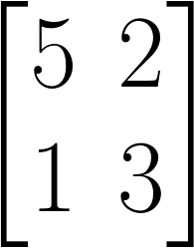
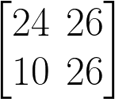
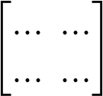
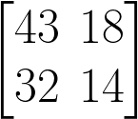
Keras BatchNormalization Layer
Dense(256)
Activation(´relu´)
Dropout(0.5)
1
A
D
2
A
D
X
BN
…
…
…
256
A
D

Slide 3
Keras Convolution Layer
model.add(Conv2D(...))
Conv2D(...)
Filters
kernel_size
strides=(1, 1)
padding='valid'
X
Conv2D(32, kernel_size=2, strides=(2,2))

Slide 4
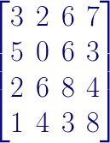
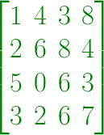
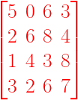
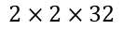
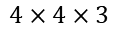
Keras Convolution Layer
Activation(´relu´)
A
D
Conv2D(32, kernel_size=(2,2), strides=(2,2))
A
D
X
$$2×2×32$$
…
…
$$4×4×3$$
32
2
A
D

Slide 5
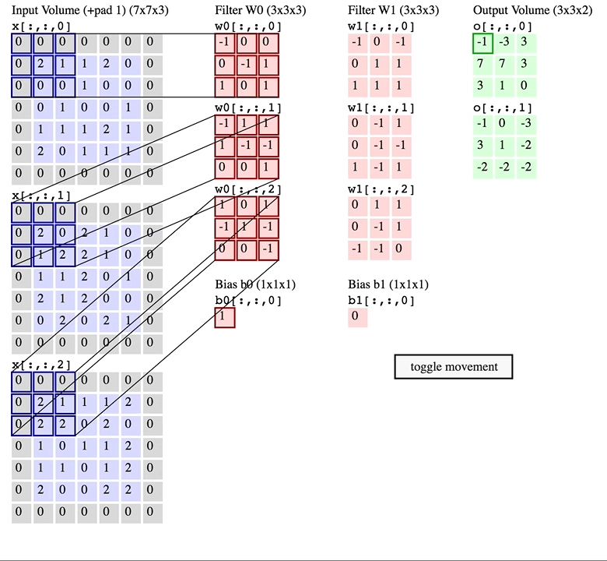
Keras Convolution Layer
Two filters (kernel) of size 3x3x3
Stride of (2,2)
Filter of 2
Zero padding

Slide 6
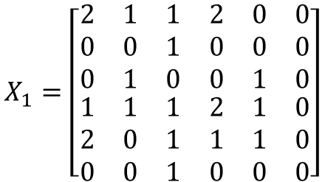
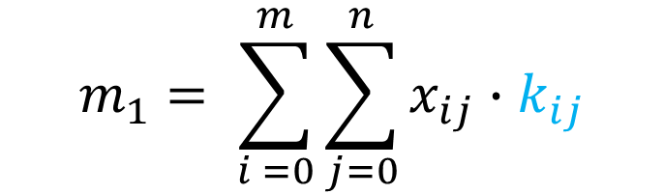
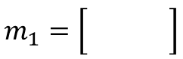
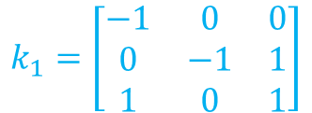
Keras Convolution Operation
Filter = 1; Stride = (3,3); Kernel = (3,3)
$$X_{1}=\left[\begin{matrix}\begin{matrix}2 & 1 \\ 0 & 0 \\ 0 & 1\end{matrix} & \begin{matrix}1 & 2 \\ 1 & 0 \\ 0 & 0\end{matrix} & \begin{matrix}0 & 0 \\ 0 & 0 \\ 1 & 0\end{matrix} \\ \begin{matrix}1 & 1 \\ 2 & 0 \\ 0 & 0\end{matrix} & \begin{matrix}1 & 2 \\ 1 & 1 \\ 1 & 0\end{matrix} & \begin{matrix}1 & 0 \\ 1 & 0 \\ 0 & 0\end{matrix}\end{matrix}\right]$$
$$k_{1}=\left[\begin{matrix}\begin{matrix}−1 & 0 \\ 0 & −1 \\ 1 & 0\end{matrix} & \begin{matrix}0 \\ 1 \\ 1\end{matrix}\end{matrix}\right]$$
$$m_{1}=\left[\begin{matrix}\begin{matrix} & \\ & \end{matrix}\end{matrix}\right]$$
$$m_{1}= \sum_{i =0}^{m}{\sum_{j=0}^{n}{x_{ij}∙k_{ij}}}$$

Slide 7
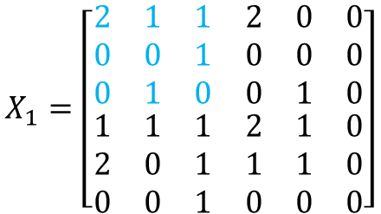
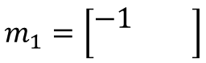
Keras Convolution Operation
Filter = 1; Stride = (3,3); Kernel = (3,3)
$$X_{1}=\left[\begin{matrix}\begin{matrix}2 & 1 \\ 0 & 0 \\ 0 & 1\end{matrix} & \begin{matrix}1 & 2 \\ 1 & 0 \\ 0 & 0\end{matrix} & \begin{matrix}0 & 0 \\ 0 & 0 \\ 1 & 0\end{matrix} \\ \begin{matrix}1 & 1 \\ 2 & 0 \\ 0 & 0\end{matrix} & \begin{matrix}1 & 2 \\ 1 & 1 \\ 1 & 0\end{matrix} & \begin{matrix}1 & 0 \\ 1 & 0 \\ 0 & 0\end{matrix}\end{matrix}\right]$$
$$k_{1}=\left[\begin{matrix}\begin{matrix}−1 & 0 \\ 0 & −1 \\ 1 & 0\end{matrix} & \begin{matrix}0 \\ 1 \\ 1\end{matrix}\end{matrix}\right]$$
$$m_{1}=\left[\begin{matrix}\begin{matrix}−1 & \\ & \end{matrix}\end{matrix}\right]$$
$$m_{1}= \sum_{i =0}^{m}{\sum_{j=0}^{n}{x_{ij}∙k_{ij}}}$$

Slide 8
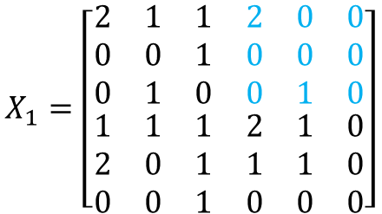
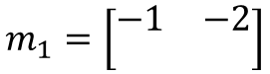
Keras Convolution Operation
Filter = 1; Stride = (3,3); Kernel = (3,3)
$$X_{1}=\left[\begin{matrix}\begin{matrix}2 & 1 \\ 0 & 0 \\ 0 & 1\end{matrix} & \begin{matrix}1 & 2 \\ 1 & 0 \\ 0 & 0\end{matrix} & \begin{matrix}0 & 0 \\ 0 & 0 \\ 1 & 0\end{matrix} \\ \begin{matrix}1 & 1 \\ 2 & 0 \\ 0 & 0\end{matrix} & \begin{matrix}1 & 2 \\ 1 & 1 \\ 1 & 0\end{matrix} & \begin{matrix}1 & 0 \\ 1 & 0 \\ 0 & 0\end{matrix}\end{matrix}\right]$$
$$k_{1}=\left[\begin{matrix}\begin{matrix}−1 & 0 \\ 0 & −1 \\ 1 & 0\end{matrix} & \begin{matrix}0 \\ 1 \\ 1\end{matrix}\end{matrix}\right]$$
$$m_{1}=\left[\begin{matrix}\begin{matrix}−1 & −2 \\ & \end{matrix}\end{matrix}\right]$$
$$m_{1}= \sum_{i =0}^{m}{\sum_{j=0}^{n}{x_{ij}∙k_{ij}}}$$

Slide 9
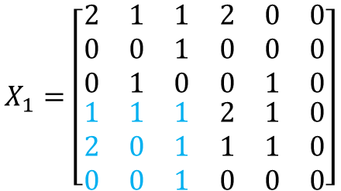
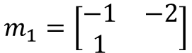
Keras Convolution Operation
Filter = 1; Stride = (3,3); Kernel = (3,3)
$$X_{1}=\left[\begin{matrix}\begin{matrix}2 & 1 \\ 0 & 0 \\ 0 & 1\end{matrix} & \begin{matrix}1 & 2 \\ 1 & 0 \\ 0 & 0\end{matrix} & \begin{matrix}0 & 0 \\ 0 & 0 \\ 1 & 0\end{matrix} \\ \begin{matrix}1 & 1 \\ 2 & 0 \\ 0 & 0\end{matrix} & \begin{matrix}1 & 2 \\ 1 & 1 \\ 1 & 0\end{matrix} & \begin{matrix}1 & 0 \\ 1 & 0 \\ 0 & 0\end{matrix}\end{matrix}\right]$$
$$k_{1}=\left[\begin{matrix}\begin{matrix}−1 & 0 \\ 0 & −1 \\ 1 & 0\end{matrix} & \begin{matrix}0 \\ 1 \\ 1\end{matrix}\end{matrix}\right]$$
$$m_{1}=\left[\begin{matrix}\begin{matrix}−1 & −2 \\ 1 & \end{matrix}\end{matrix}\right]$$
$$m_{1}= \sum_{i =0}^{m}{\sum_{j=0}^{n}{x_{ij}∙k_{ij}}}$$

Slide 10
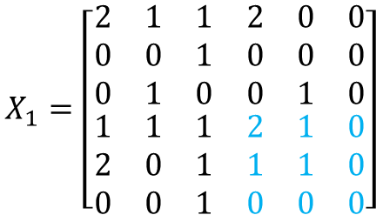
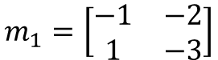
Keras Convolution Operation
Filter = 1; Stride = (3,3); Kernel = (3,3)
$$X_{1}=\left[\begin{matrix}\begin{matrix}2 & 1 \\ 0 & 0 \\ 0 & 1\end{matrix} & \begin{matrix}1 & 2 \\ 1 & 0 \\ 0 & 0\end{matrix} & \begin{matrix}0 & 0 \\ 0 & 0 \\ 1 & 0\end{matrix} \\ \begin{matrix}1 & 1 \\ 2 & 0 \\ 0 & 0\end{matrix} & \begin{matrix}1 & 2 \\ 1 & 1 \\ 1 & 0\end{matrix} & \begin{matrix}1 & 0 \\ 1 & 0 \\ 0 & 0\end{matrix}\end{matrix}\right]$$
$$k_{1}=\left[\begin{matrix}\begin{matrix}−1 & 0 \\ 0 & −1 \\ 1 & 0\end{matrix} & \begin{matrix}0 \\ 1 \\ 1\end{matrix}\end{matrix}\right]$$
$$m_{1}=\left[\begin{matrix}\begin{matrix}−1 & −2 \\ 1 & −3\end{matrix}\end{matrix}\right]$$
$$m_{1}= \sum_{i =0}^{m}{\sum_{j=0}^{n}{x_{ij}∙k_{ij}}}$$

Slide 11

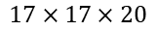
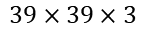
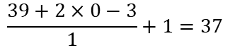
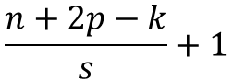
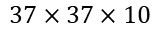
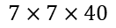
Keras Convolutional Neural Network
Dense(1960)
1
Filter=10
Kernel_size=(3,3)
Stride=(1,1)
Padding=0 or Valid
Filter=20
Kernel_size=(5,5)
Stride=(2,2)
Padding=0 or Valid
Filter=40
Kernel_size=(5,5)
Stride=(2,2)
Padding=0 or Valid
2
1
…
2
$$39×39×3$$
$$37×37×10$$
$$17×17×20$$
$$7×7×40$$
1960
$$\frac{n+2p−k}{s}+1$$
Je Tiefer im Netz je kleiner die Dimension und je größer die Filter
$$\frac{39+2×0−3}{1}+1=37$$

Slide 12
Saif Al-Dilaimi
Software Entwickler
saif.aldilaimi@icloud.com
Danke fürs Zuhören!
Gleich geht es weiter mit dem nächsten Thema.

